Slide 1




Social Media Trend Prediction
S.chaitra-2410030171,A.srija-2410030349,D.pravalika-2410030246,
V.cherishma-2410030440

Slide 2


Social Media Trends
The use of hashtags has significantly influenced social media trends, enabling users to connect, share, and discover content. Predicting trending hashtags can help brands, media, and researchers stay ahead.Our project builds a system to analyze hashtags and predict upcoming trends.

Slide 3

Problem Statement
In today's digital age, effective hashtag analysis is crucial for understanding social media trends. Manual tracking of trending hashtags is inefficient.
No centralized platform predicts hashtag trends in real-time.There is a gap in combining prediction and visualization in one system.
Objective: Create a web dashboard to predict and visualize emerging hashtag trends.

Slide 4
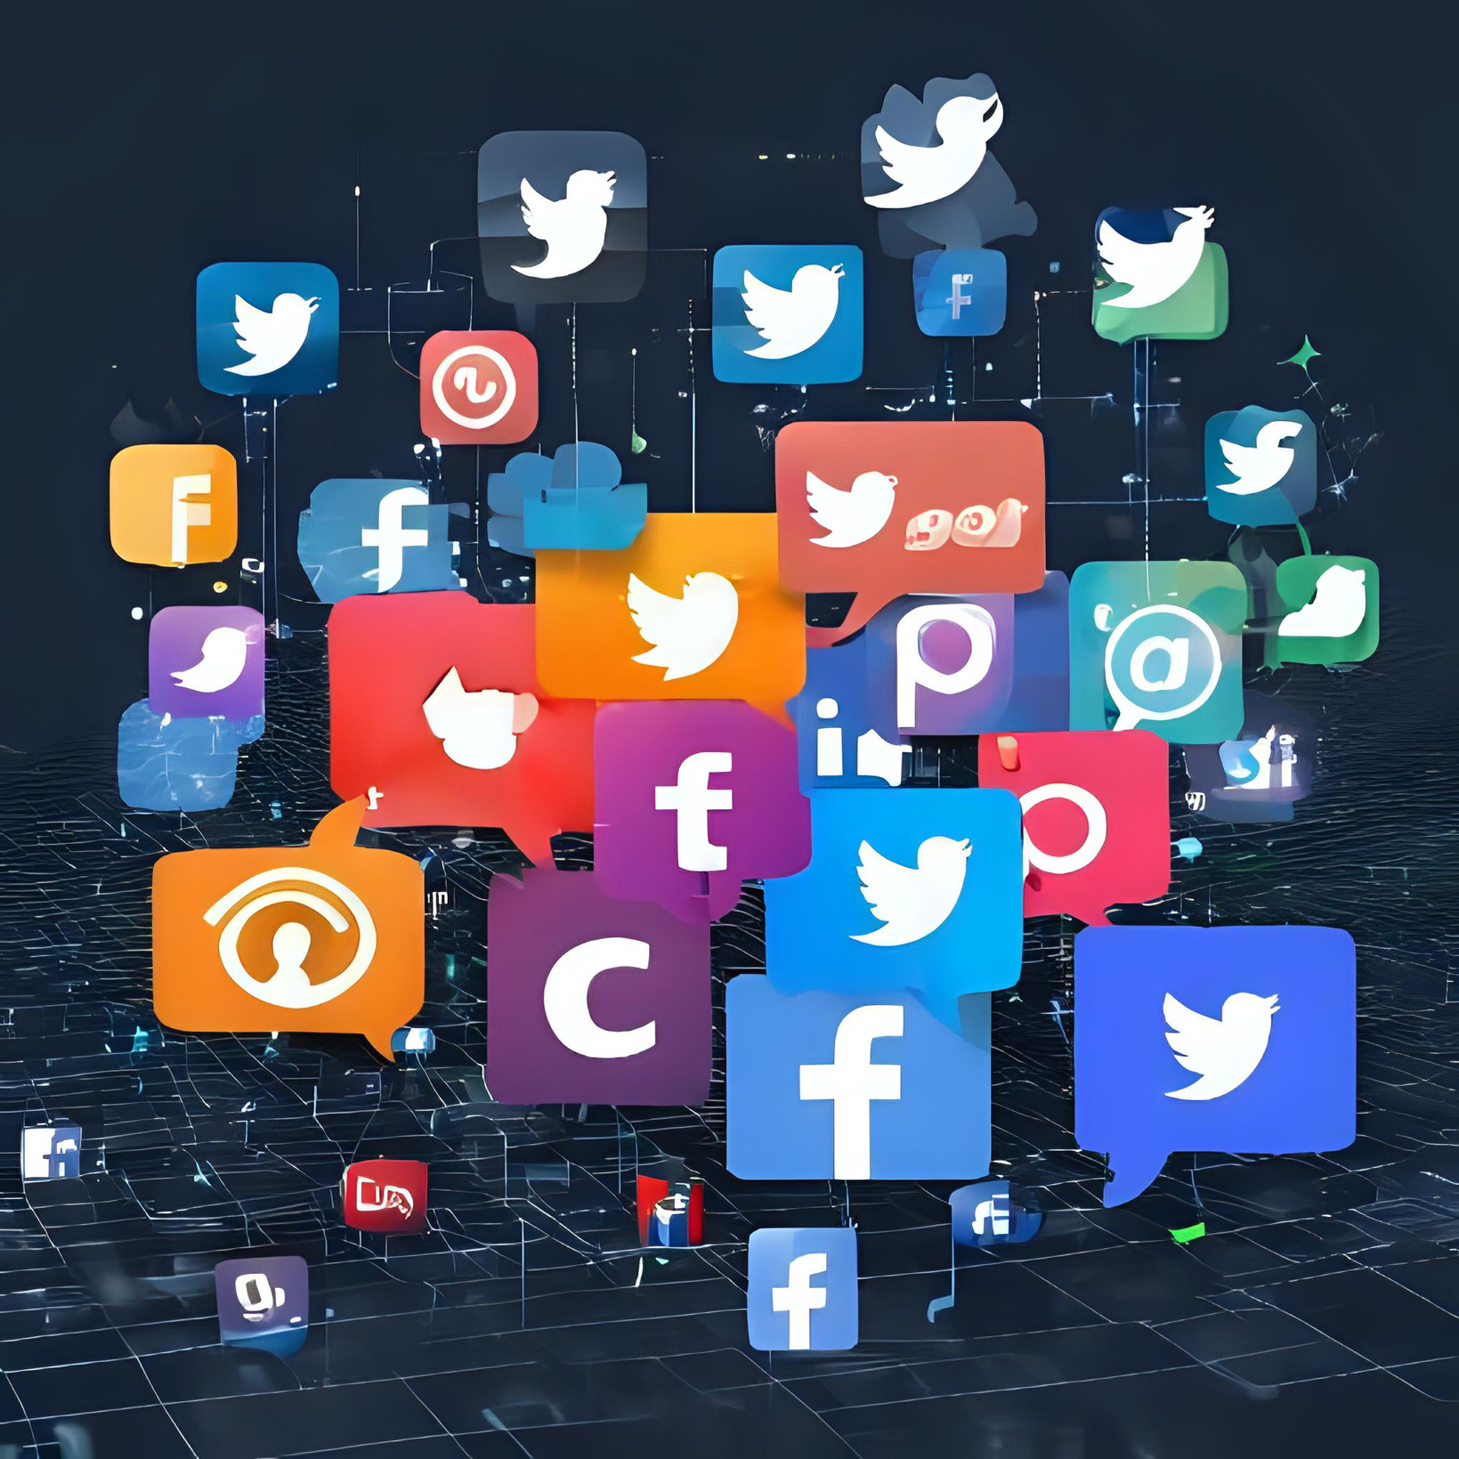
Research Paper-1,2
The research papers from IEEE and Springer, 2023,2021 highlights the influence of hashtags on shaping social media trends. It emphasizes the role of data analysis in predicting user engagement and content virality across platforms.

Slide 5

Research
Paper -3,4
The 2019 Springer research paper and 2020 IJCA research paper, highlights key findings about hashtag usage, illustrating how strategic tagging can enhance visibility and engagement on social media platforms, ultimately impacting marketing effectiveness.

Slide 6

Proposed System Flow
Initial Research
Data Analysis
Model Implementation
Results Evaluation
Collect data using Twitter API or public datasets.Preprocess tweets: clean, extract hashtags, and timestamps.
Analyzing hashtag patterns and trends effectively.
Implementing machine learning for predictions.
Visualize trends on a live web dashboard.

Slide 7

Technologies Used Overview
Frontend
Backend
ML & NLP
Visualization
Dataset Source
HTML, CSS, JavaScript, React
Python (Flask / FastAPI)
scikit-learn, NLTK, pandas
Matplotlib, Seaborn, Chart.js
Twitter API / Kaggle

Slide 8

Dataset Overview
Source: Twitter API / Kaggle
Fields used: Hashtags, tweet text, timestamp, engagement metrics.
Steps:
Clean raw data (remove spam, symbols)
Extract hashtags and group by time
Remove stopwords, tokenize, normalize

Slide 9

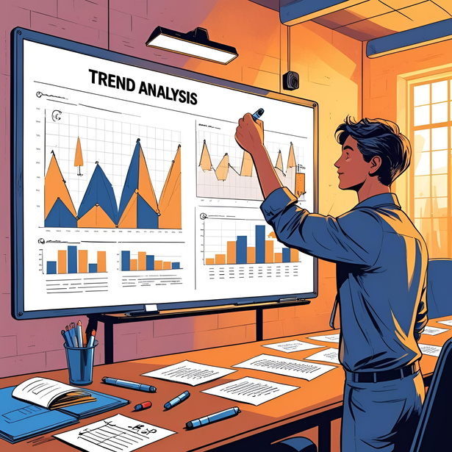



Visual Representations of Results
Trend Analysis
Hashtag Word Cloud
Interactive Dashboard
Summary Graph
Graph of hashtag frequency over time.
Word cloud of most popular hashtags today.
Dashboard displays predictions like:
“#EcoFest2025 is likely to trend tomorrow”
Overall trend insights

Slide 10

Future Possibilities
The real-time analysis of social media trends will enhance our understanding of public sentiment, enabling businesses to adapt quickly. Mobile applications will further facilitate immediate engagement and sentiment tracking.

Slide 11
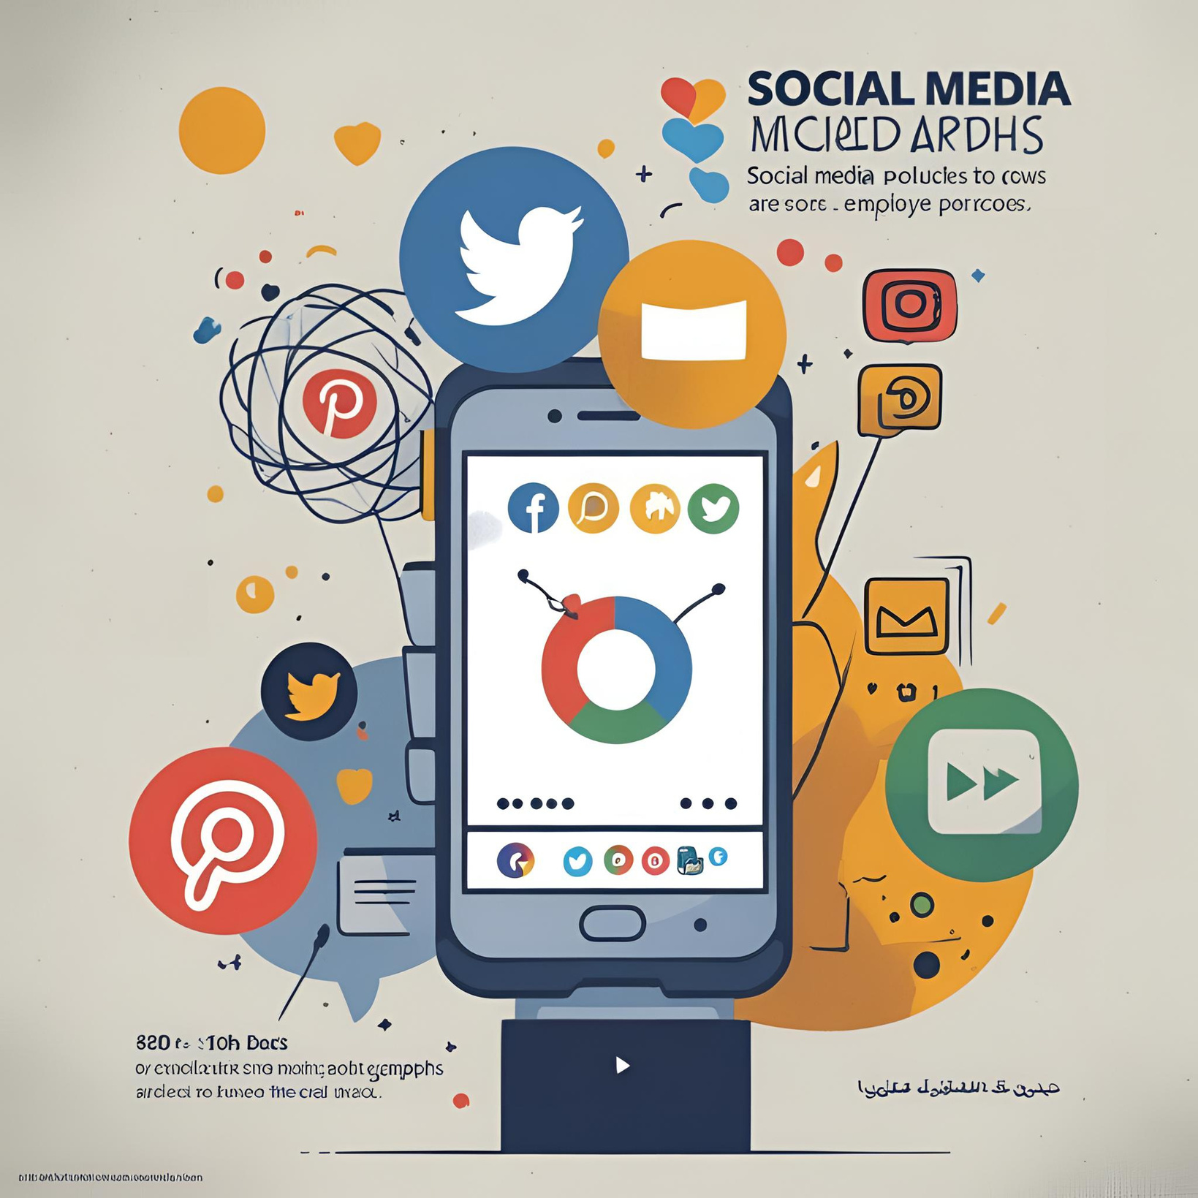
Conclusion
The system demonstrates significant effectiveness in predicting trends through hashtag analysis, enabling efficient marketing strategies and enhancing user engagement across various platforms, ultimately allowing businesses to adapt their approaches effectively.

Slide 12


Thank You!

